Slide 1
Computer Organization
2015 - 2016

Slide 2
Instructors
Course By:
Lecturer: Shimaa Ibrahim Hassan
TA: Eng: Moufeda Hussien
Lecture: Wednesday @ 9:45
Email Address: shaimaa.rizk@feng.bu.edu.eg
Alt. Email: shimaahassan4779@gmail.com

Slide 3
Course Objectives
Describe the general organization and architecture of computers.
Identify computers’ major components and study their functions.
Introduce hardware design issues of modern computer architectures.
Learn assembly language programming.
Build the required skills to read and research the current literature in computer architecture.

Slide 4
Text Books
“Computer Organization and Design”, 4th Edition, Patterson & Hennessy, © 2008
“Computer Organization,” by Carl Hamacher, Zvonko Vranesic and Safwat Zaky. Fifth Edition McGraw-Hill, 2002.
“SPARC Architecture, Assembly Language Programming and C,” Richard P. Paul, Prentice Hall, 2000.

Slide 5
Grading System
Final exam .................................... 75 degrees
Mid-term .................................... 20 degrees
Sec. Work ................................... 20 degrees
Quizies .......................................... 10 degrees

Slide 6
Important Prerequisite Material
Digital Logic Course is fundamental to the Computer Organization Course.
Review issues in:
- Basic computer organization: CPU, Memory, I/O, Registers.
- Simple ALU, simple register design.

Slide 7
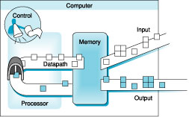
Under the Covers
Five classic components of a computer: input, output, memory, datapath, and control
datapath + control = processor (CPU) (it manipulates instructions and data)

Slide 8
What is a Computer?
a computer is a sophisticated electronic calculating machine that:
Accepting information to be processed as input.
Storing a list of instructions to process the information.
Processing the information according to the list of instructions.
Providing the results of the processing as output.

Slide 9
Functional Units of a Computer
Input unit accepts
information:
Human operators,
Electromechanical devices (keyboard)
Other computers
Arithmetic and logic unit(ALU):
Performs the desired
operations on the input
information as determined
by instructions in the memory
Memory
Arithmetic
& Logic
Input
Instr1
Instr2
Instr3
Data1
Data2
Output
Control
I/O
Processor
Stores
information:
Instructions,
Data
Control unit coordinates
various actions
Input,
Output
Processing
Output unit sends
results of processing:
To a monitor display,
To a printer

Slide 10
Input Unit
Tasks are performed by the input unit:
- Interfaces with input devices.
- Accepts binary information from the input devices.
- Presents this binary information in a format expected by the computer.
- Transfers this information to the memory or processor.

Slide 11
Memory Unit
Memory unit stores instructions and data as a series of bits.
Processor reads instructions and reads/writes data from/to the memory during the execution of a program.
In theory, instructions and data could be fetched one bit at a time.
In practice, a group of bits is fetched at a time.
Group of bits stored or retrieved at a time is termed as “word”
Number of bits in a word is termed as the “word length” of a computer.

Slide 12
Memory Unit (cont.)
Processor reads/writes to and from memory based on the memory address:
Access any word location in a short and fixed amount of time based on the address.
Random Access Memory (RAM) provides fixed access time independent of the location of the word.
Access time is known as “Memory Access Time”.
Memory and processor have to “communicate” with each other in order to read/write information.
In order to reduce “communication time”, a small amount of RAM (known as Cache) is tightly coupled with the processor.

Slide 13
Memory Unit: Primary Storage
Primary storage of the computer consists of RAM units.
Fastest, smallest unit is Cache.
Slowest, largest unit is Main Memory.
Primary storage is insufficient to store large amounts of data and programs.
Primary storage can be added, but it is expensive.

Slide 14
Memory Unit: Secondary Storage
Store large amounts of data on secondary storage devices:
Magnetic disks and tapes,
Optical disks (CD-ROMS).
Access to the data stored in secondary storage in slower, but take advantage of the fact that some information may be accessed infrequently.
Cost of a memory unit depends on its access time, lesser access time implies higher cost.

Slide 15
Instructions
Instructions specify commands to:
Transfer information within a computer (e.g., from memory to ALU)
Transfer of information between the computer and I/O devices (e.g., from keyboard to computer, or computer to printer)
Perform arithmetic and logic operations (e.g., Add two numbers, Perform a logical AND).

Slide 16
Instructions (cont.)
A sequence of instructions to perform a task is called a program, which is stored in the memory.
Processor fetches instructions that make up a program from the memory and performs the operations stated in those instructions.
Instruction Example:
add a,b,c

Slide 17
Data
Data are the “operands” upon which instructions operate.
Data could be:
Numbers,
Encoded characters.
Data, in a broad sense means any digital information.
Computers use data that is encoded as a string of binary digits called bits.

Slide 18
Arithmetic and Logic Unit (ALU)
Operations are executed in the Arithmetic and Logic Unit (ALU).
Arithmetic operations such as addition, subtraction.
Logic operations such as comparison of numbers.
In order to execute an instruction, operands need to be brought into the ALU from the memory.
Operands are stored in general purpose registers available in the ALU.
Access times of general purpose registers are faster than the cache.
Results of the operations are stored back in the memory or retained in the processor for immediate use.

Slide 19
Registers
Register is a very fast computer memory used to speed the execution of computer programs
Registers are the top of the memory hierarchy, and are the fastest way for the system to manipulate data.
They are normally measured by the number of bits they can hold, for example, an “8-bit register” or a “32-bit register”, actually according to the memory word size

Slide 20
Registers (cont.)
There are several other classes of registers:
(a) General Purpose Registers: General purpose registers are used to store data and intermediate results during program execution. Its contents can be accessed through assembly programming (R1, R2, R3,…….)
(b) Special Purpose Registers: Users do not access these registers. These are used by computer system at the time of program execution.

Slide 21
Special Purpose Registers
Some types of special purpose registers are given below:
Memory Address Register (MAR): It stores address of data or instructions to be fetched from memory
Instruction Register (IR): stores the instruction currently being executed . When one instruction is completed, next instruction is fetched in memory for processing.
Program Counter (PC): holds the address of the instruction that should be executed next

Slide 22
Output Unit
Computers represent information in a specific binary form. Output units:
- Interfaces with output devices.
- Accepts processed results provided by the computer in specific binary form.
- Converts the information in binary form to a form understood by an
output device.

Slide 23
Control unit
Operation of a computer can be summarized as:
Accepts information from the input units (Input unit).
Stores the information (Memory).
Processes the information (ALU).
Provides processed results through the output units (Output unit).

Slide 24
Control unit (cont.)
Operations of Input unit, Memory, ALU and Output unit are coordinated by Control unit.
Instructions control “what” operations take place (e.g. data transfer, processing).
Control unit generates timing signals which determines “when” a particular operation takes place.

Slide 25
Buses
Input
Output
Memory
Processor
Bus
For a computer to achieve its operation, the functional units need to communicate with each other.
Functional units may be connected by a group of parallel wires.
The group of parallel wires is called a bus.
Each wire in a bus can transfer one bit of information.
The number of parallel wires in a bus is equal to the word length of a computer

Slide 26
Below the Program
Applications software
Systems software
Hardware

Slide 27
Below the Program (cont.)
System software
Operating system – supervising program that interfaces the user’s program with the hardware (e.g., Linux, MacOS, Windows)
Handles basic input and output operations
Allocates storage and memory
Provides for protected sharing among multiple applications
Compiler – translate programs written in a high-level language (e.g., C, Java) into instructions that the hardware can execute

Slide 28
From a High-Level Language to the Hardware Language
A high-level programming language is composed of words and algebraic notation that can be translated by a compiler into assembly language
Assembly language symbolically represents machine instructions
An assembler translates a symbolic version of a machine instruction into its binary version

Slide 29
From a High-Level Language to the Hardware Language (cont.)
Machine language is the binary representation of machine instructions
Instructions and data are just collection of binary digits (bits)
Instructions are individual commands that computers understand and obey
Hardware executes machine instructions (extremely simple low-level instructions)

Slide 30
From a High-Level Language to the Hardware Language (cont.)
High-level language program (in C)
swap (int v[], int k)
( int temp;
temp = v[k];
v[k] = v[k+1];
v[k+1] = temp;
)
Assembly language program (for MIPS)
swap: sll $2, $5, 2
add $2, $4, $2
.
.
jr $31
Machine (object, binary) code (for MIPS)
000000 00000 00101 0001000010000000
000000 00100 00010 0001000000100000
. . .
C compiler
assembler

Slide 31
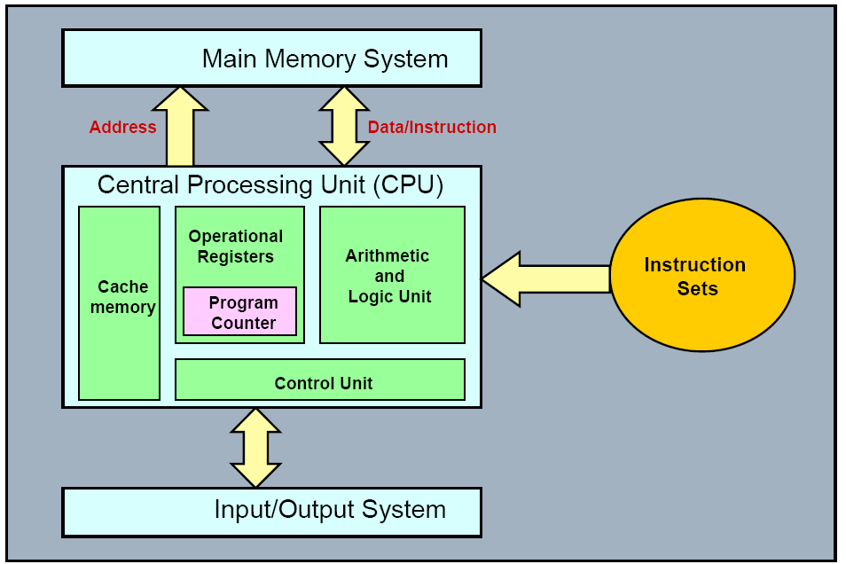
Content Coverage

